Slide 1


Mobisec Unveiled: A Tactical Communication Approach
Luca Calabrese
Marco Marchiante
Alberto Penzo
Dilmurod Rustam Ugli Rakhmatov
Gabriel Rovesti

Slide 2

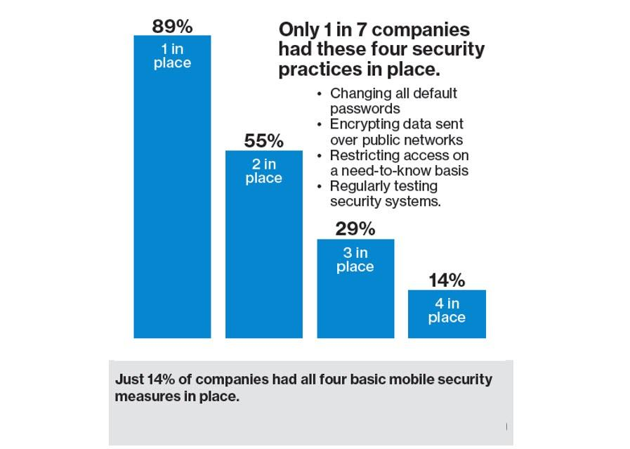



Mobisec: How winners play it better
Brand Awareness
Engaging Narrative
Unique Products
Training & Projects
1 - https://www.forbes.com/sites/louiscolumbus/2018/04/08/83-of-enterprises-are-complacent-about-mobile-security/

Slide 3
Understanding the offerings
1
3
5
MOBISEC DSA
Comprehensive data monitoring and security
Proactive approach to identifying and addressing security vulnerabilities
MOBISEC UEM
Manage and secure corporate devices
Balances user experience with robust security measures
Cybersecurity Training
Mitigates risk through well-trained staff
Tailored training programs
2
MOBISEC HIWAVE
Secure and manage IoT ecosystems
Emphasis on data monitoring
4
App Scraping
Identify market gaps
Predict app advancements
Stay ahead of competition

Slide 4

Audience Analysis
Customers
Audience
Mobisec UEM
Cybersecurity training
Decision-making power
Risk profiles awareness
Mid-Large Corporation
Daily PC usage
Network administrators
CTOs
IT Managers
Information Security Offices
IOT Management
Mobile App Development
Startups
Rapid growth

Slide 5
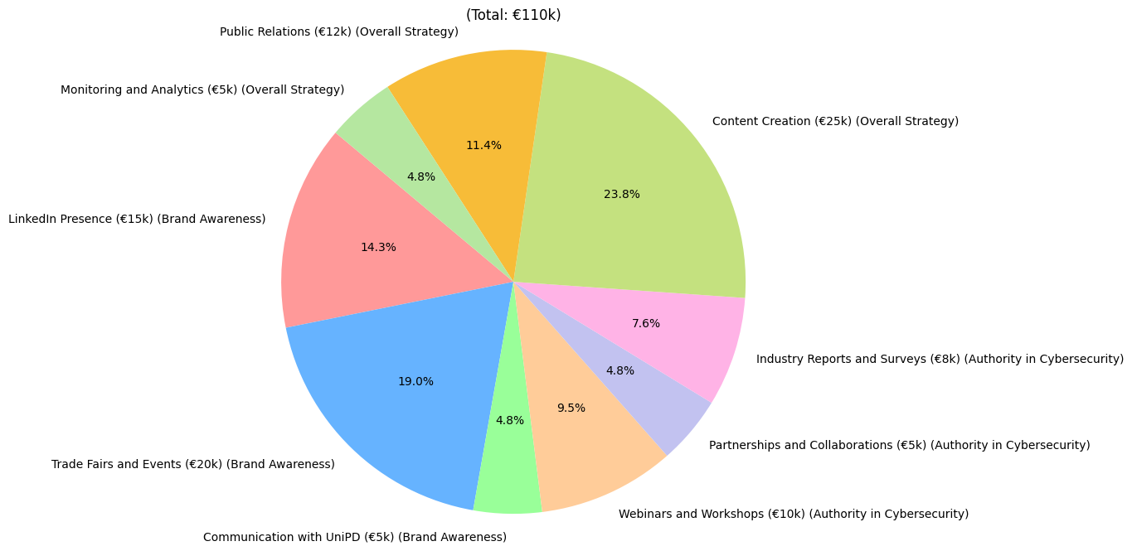
Budget Analysis
2 - https://www.linkedin.com/advice/0/what-best-tools-methods-track-report-communication

Slide 6




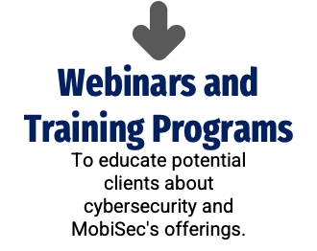
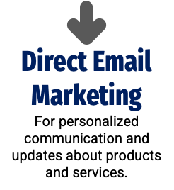




Channels Analysis

Slide 7
Tasks Analysis
How do we hook and retain new customers?
By building a compelling messaging plan based on these factors:
Consistency: ensuring consistency across channels reinforces the brand and helps to build trust
Frequency: helps in reinforcing key messages and with brand exposure
Engagement: build brand awareness and contributes to relationship building
Educational tone: educating the audience about the importance of mobile security and the unique benefits of Mobisec’s product
Testimonials: help to build trust and credibility
Call to actions: it encourages further exploration and interaction

Slide 8
Tasks Analysis
LinkedIn
Mobisec website
Webinars & Industry events
Profile optimization
Content calendar
Employee engagement
Showcasing products and services
Event participation announcements
Blog/Insights section
Customers success stories
Interactive website content
Innovative product demos
SEO optimization for better search engine visibility
Online courses on comprehensive mobile security topics
Use of mainstream platform like Zoom
Client engagement through Q&A sessions
Post-event surveys for feedback

Slide 9




Mobisec Messages and Goals
Knowledge
Presence
Reference
Visibility
Transmit reliability and knowledge
Transmit a sense of continuous presence for customers
Become a reference for customers
Increase visibility

Slide 10
Future needs and critical thoughts
Accessible
Helping in technical knowledge acquisition by companies and individuals alike
Innovative
Try to follow latest tendencies with a forward-thinking, trying a “lean marketing approach”
Important
Regular monitoring of messaging through metrics such as customer engagement and conversion rates

